Slide 1
International Business
22MBA401
CORE SUBJECT
                Course Coordinator:
                Prof. Madhunayaka
                Assistant Professor,
                Department of MBA,
                VVIET , Mysuru

Slide 2
Module-1 (6Hours)
Introduction to International Business: Evolution, Meaning, Importance, Nature and Scope of International
Business, Characteristics of International Business, Factors affecting International Business, Changing scenario of International Business, Advantages of International Business, challenges in International business, Modes of entry into International Business, Internationalization Process.
Contents of MODULE - 1

Slide 3

Introduction to International Business
International business is a dynamic field driven by globalization and the pursuit of new opportunities. It demands adaptability, strategic planning, and understanding diverse cultures and legal frameworks to navigate complexities and achieve growth and success.

Slide 4
Evolution-IB
International business has undergone a significant transformation from ancient trade routes to today's complex global networks. This evolution, driven by technological advancements and shifts in economic and political landscapes, has reshaped how companies operate across borders and interact with diverse markets.
Key phases in the evolution of international business
Ancient civilizations and trade routes
Colonialism and the Age of Imperialism
The Industrial Revolution and accelerated trade
Post-World War II era and globalization
The digital revolution and e-commerce

Slide 5
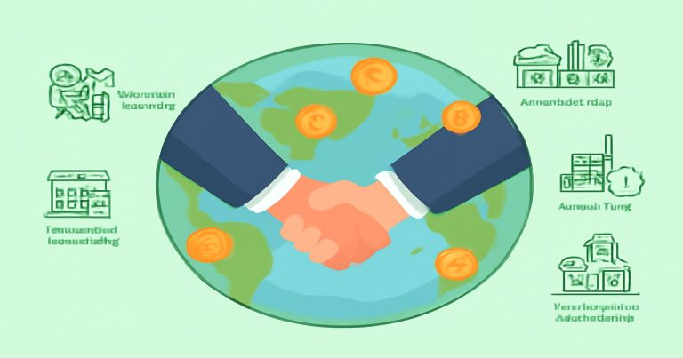
Meaning-IB
International business refers to the trade of goods, services, technology, capital, and/or knowledge across national borders and at a global scale. It encompasses various forms of business activities that occur between two or more countries. The scope of international business includes not only the exchange of products and services but also activities such as investment, joint ventures, strategic alliances, and the management of multinational enterprises (MNEs).

Slide 6
Importance of International Business
International business has become an important aspect in the world today. It is a field that helps firms to develop, creates sites of work, and builds relationships at the global level. The importance of international business to the world cannot be understated in a global economy.
  Why is International Business Important?
  International business helps its case in many ways. The importance of international business lies in its effect on making life better for every human being. It builds a world that is closely connected, free, and filled with opportunities.
  The main reasons are as follows:
  Promote company growth: By entering into foreign markets, companies generate more profit.
  Brings new technologies and ideas: Global trade introduces novel ideas and methods for doing business.
  Improves product quality: Heightened competition will force companies to improve product quality.
  Generates employment: New ventures in international business generate employment opportunities in multiple areas.
  Builds friendship among nations: Trade builds peace and goodwill among nations.

Slide 7
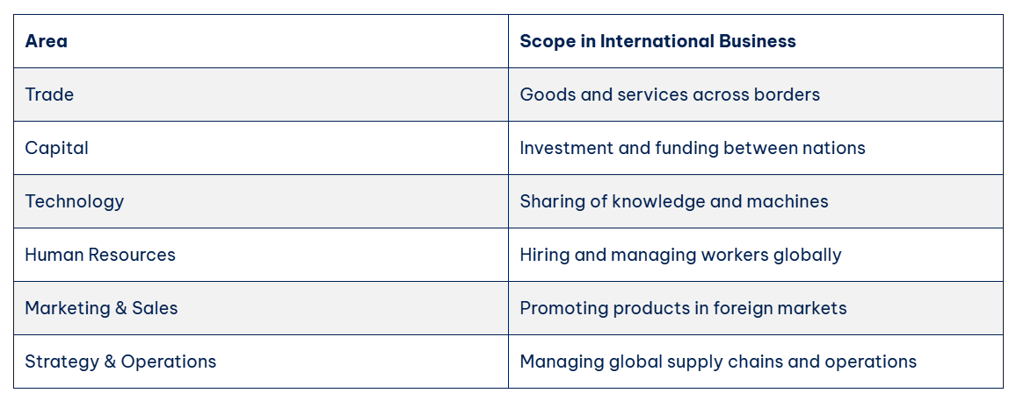
Nature and Scope of International
Business
The horizon of international business is very wide. It teems with all aspects of a business. From production to sales and marketing, from finances to the management of human resources, international business has an impact on everything.
Trade of Goods and Services: It describes the trade associated with the exchange of physical products like clothes, electronics, and food, as well as services like tourism, banking, and software.
Capital and Technology Flow: It includes international investments in foreign companies and technology-sharing-derived improvements in products and services developed under such agreements.
Movement of Labor: Indeed, laborers find a job overseas. It benefits both the worker and the organization.
Global Marketing and Branding: Companies craft global marketing strategies. It builds the brand across countries.
International Business Management :This involves planning, organizing, and controlling business in more than one country. It requires that managers understand different cultures and laws and markets.

Slide 8
Characteristics of International Business
One would think that international business covers so much, but it merely offers different types of international business in which each company selects the type most suitable for them. The definition of the types of international business depends on what is traded and how the exchange is carried out.
Export/Import: This is the simplest form. Export means selling goods to another country. Import means buying goods from another country. For example, India exports tea and imports oil.
Licensing & Franchising: Licensing permits companies in one country to use a product or brand from another company. Franchising is a similar concept in which a larger proportion of the business model is included. McDonald’s in India is a franchise of the US brand.
Joint Ventures: This is an international business carried on by companies from two different countries, sharing the profits and risks, thus helping both parties learn and grow together.
Foreign Direct Investment: Foreign direct investment implies that one country is investing in a business in another country. This may actually mean going into the other country and building factories or buying companies.
Contract Manufacturing: A firm in one country gets another firm in another country to produce products for it. This is what many tech companies do with China or India.

Slide 9
Factors affecting International Business
International business is affected by various things, which must be considered before entering a new market. These factors affecting international business can be a deal-maker or a dealbreaker.
Economic Environment: Business is affected by national income, inflation and taxation. These are significant factors in attracting foreign companies to much stronger economies.
Political and Legal Systems: Countries vary in terms of their laws. Some are prohibitive for business activities, while others are favorable. The stability of the government has a lot to do with investments.
Cultural Disparities: As a rule, any particular culture has a lot in terms of language, religion, and customs. Businesses should respect and incorporate those local traditions into their practices and operations.
Level of Technology: Developed nations create obstacles, including pieces of machinery and the Internet, which will make the business run perfectly.
Foreign Exchange Rates and Currency Risk: The currency keeps changing its value in different countries. Hence, it may bring profit or a huge loss. Organizations have to diversify their risk.
Trade Barriers and Tariffs: Some countries impose extra taxation on imports, while others block certain imports entirely. Business planners will have to make calculations concerning these costs.

Slide 10
Changing scenario of International Business
The international business landscape is a dynamic and constantly evolving environment influenced by a combination of technological, political, economic, and social factors.
Globalization and interconnectedness
Technological advancements and digital transformation
Geopolitical shifts and trade policies
Sustainability and ethical considerations
Emerging markets and growth opportunities
Remote work and global workforce management

Slide 11
Advantages of International Business
International business presents companies with the potential for growth and expansion. The benefits businesses can acquire in international business are new markets, cost reductions, and reputation improvement. Businesses with international operations benefit from global skills, sophisticated technology, and world resources.
Effective Use of Resources: Different countries have different types of natural and human resources. Due to international trade, countries can specialize in producing the products in which a particular country has comparative advantages. Therefore, they make the goods on which they are comparatively advantageous, and other stuff is imported that they cannot manufacture properly.
Cost Reduction: In international trade, companies get the opportunity to acquire raw materials and labour from countries where costs are cheaper. Many industries have set up production facilities in countries where labor wages are minimal, taxes are lesser, and economic policies are friendly.
Consumers benefit from international trade, too, because they get imported goods at relatively more affordable prices. Consumers get better purchasing power. Consumers get upgraded living standards.
Increased Market: The constraints of domestic markets are their demand, resources, and customers. International trade may open gates for a firm to access much larger markets than national markets. Firms that trade across borders can sell to millions of customers worldwide.

Slide 12
challenges in International business
Language, business etiquette, and consumer behavior vary with countries. A company must adopt marketing and customer service according to the culture’s preferences. Other countries have several legal and regulatory requirements for businesses. Political instability, trade barriers, and government policies might hinder international operations.
Natively, companies can take advantage of but they also come with some challenges:
Business Culture in Various Countries: Each country has its own customs in business.
Policies: Tariffs, international trade agreements, and regulations affect to operations of business.
Global Risk Management: Currency movements and political instability are types of financial risk.
Making strategic choices is significant in international business when entering foreign business

Slide 13
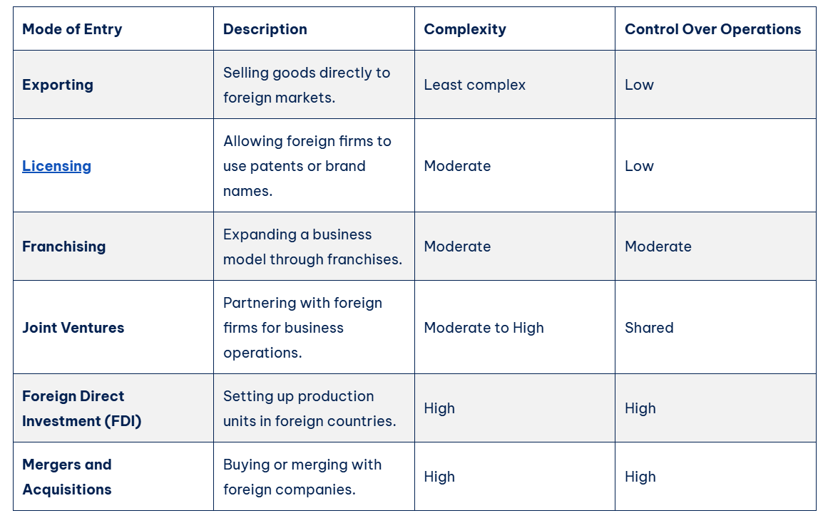
Modes of entry into International Business
International market entry can be done through various modes. Every mode of entry has its benefits and risks. The table below gives a general overview of the standard modes of entry:

Slide 14
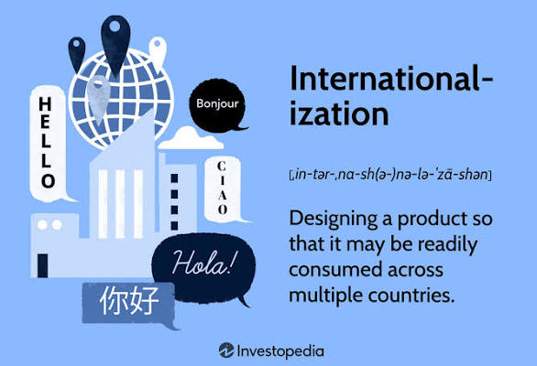
Internationalization Process
Domestic Stage: Companies primarily focus on their home market and domestic opportunities.
International Company: Businesses venture beyond national borders, often through exporting or establishing branches and subsidiaries in foreign countries.
Multinational Company (MNC): MNCs adapt products, services, and strategies to specific country markets, addressing local needs and preferences.
Global Company: These companies adopt a global strategy, leveraging global production and marketing for worldwide reach and efficiency.
Transnational Company: The most integrated stage, transnational companies operate globally, combining global efficiency with local responsiveness, often managing operations across borders while maintaining centralized control.

Slide 15
Thank You
Emerging Trends in Marketing

